Slide 1
Best Coffee Shop location in LA
Best Coffee Shop location in LA

Slide 2
Los Angeles is a big city where a lot of coffee is used
As in any large urban center there are a lot of people doing a lot of work each and every day. All these people need coffee.
New businesses spring up all the time in an area such as this and what makes or breakes them is location(nobody wants to sit 2 hours in traffic just to get some coffee)
Helping new coffee shops choose the best location is going to make a big difference in how solvent and profitable they are

Slide 3
Data
https://en.wikipedia.org/wiki/List_of_districts_and_neighborhoods_of_Los_Angeles => data regarding the various neighbourhoods of LA
http://geohub.lacity.org/datasets/d6c55385a0e749519f238b77135eafac_0/geoservice => smaller dataset of the LA neighbourhoods, with the possibility of getting a map of the city+districts
https://simplemaps.com/data/us-zips => data of the USPS zip codes(along with location data long-lat for each), has to be sifted for relevant information
( main data base used )
The data was scrubbed as it contained info on the entire US and quite a lot of extra unnecessary data.

Slide 4
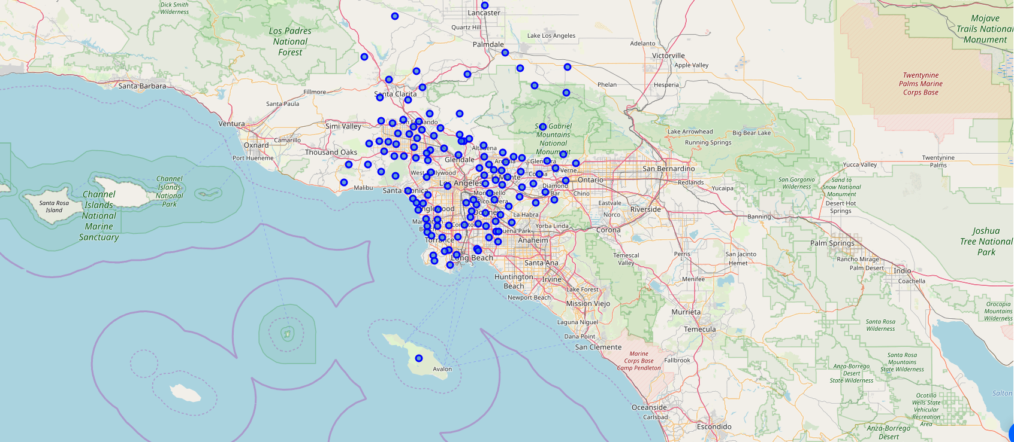
Mapping everything for ease of use

Slide 5
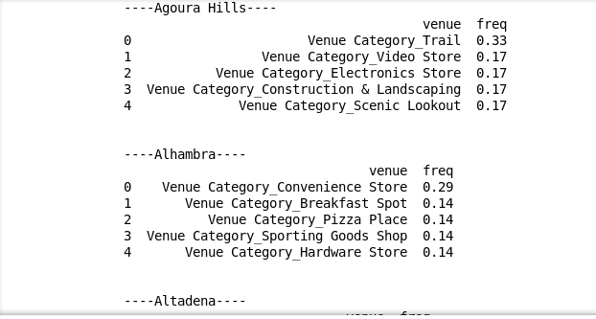
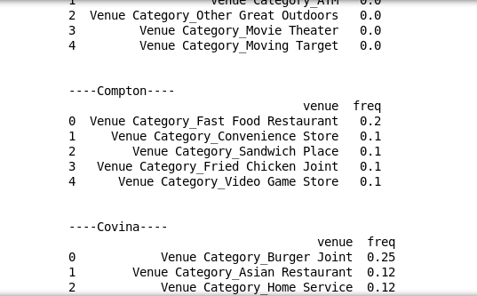
A quick glipse into what people like

Slide 6
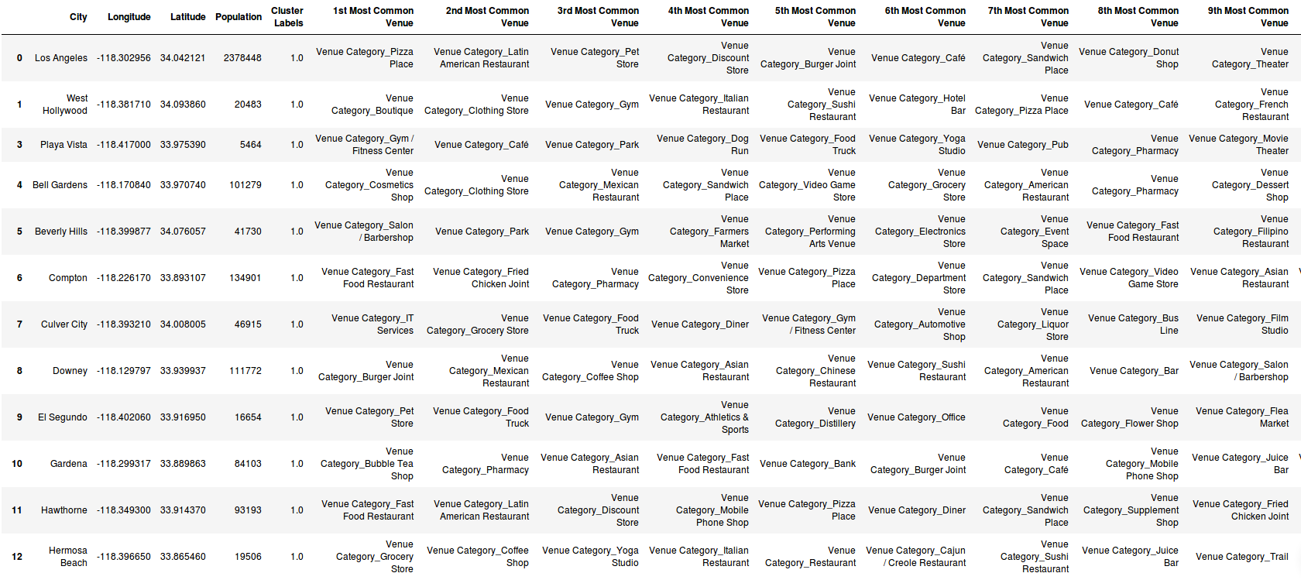
Grouping everything based on popular venue types

Slide 7
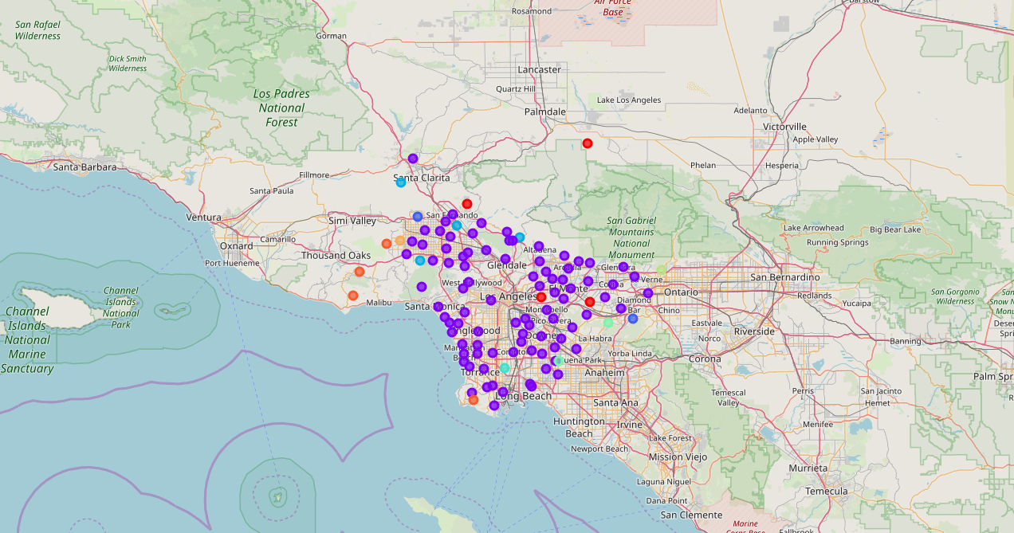
Mapping the Clusters

Slide 8
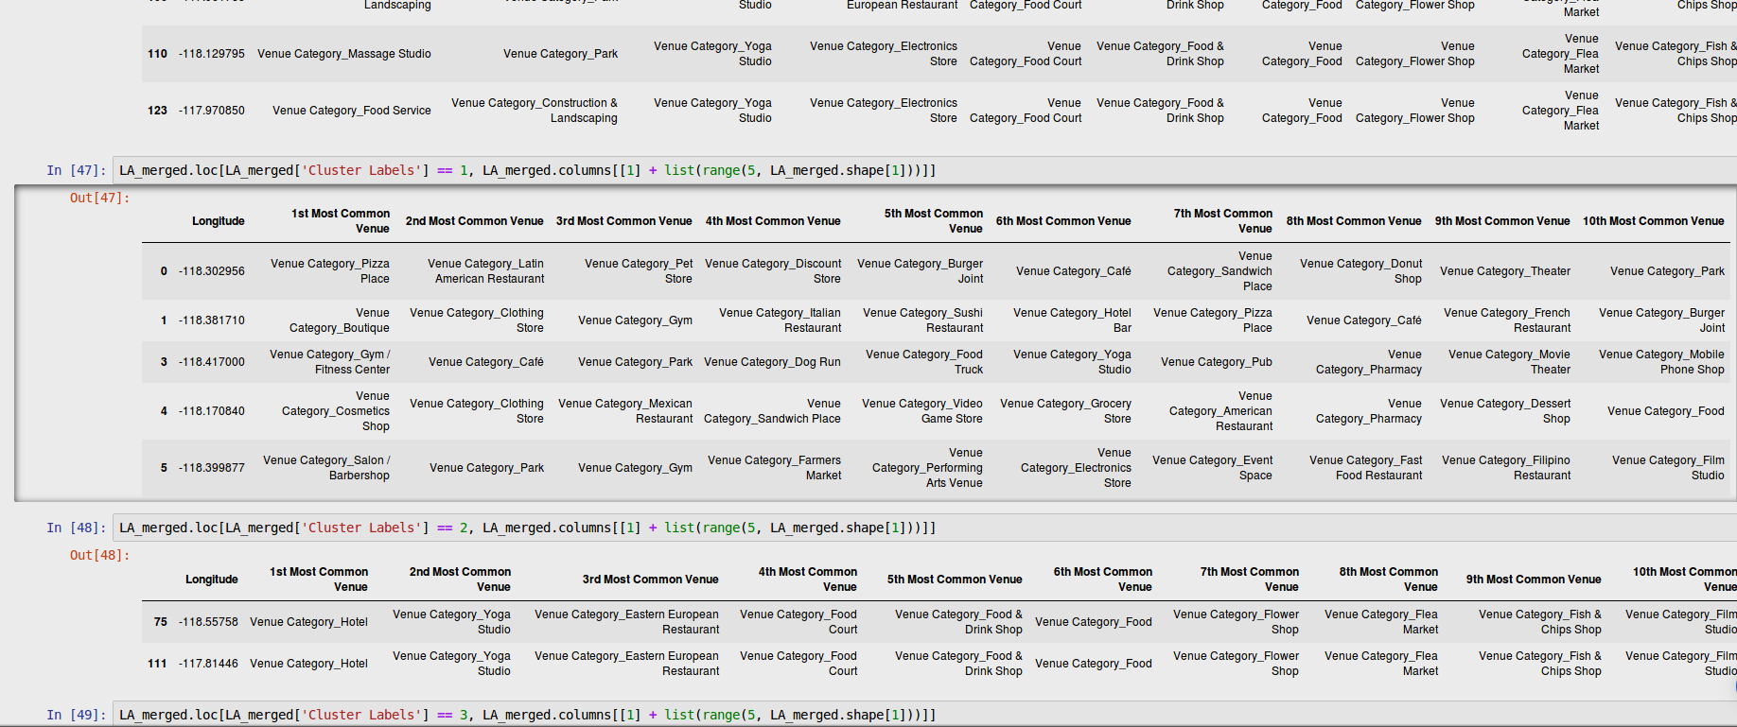
Finally Analysing Everything

Slide 9
Conclusion and Directions
The model groups the cities based on venues and that then gives us the required information to choose the best place for our new coffee shop. It also provides data about population numbers in each city, thus giving us an easy way of estimating profits and popularity
In the future the model may be updated with real estate data as well, thus giving us a precise initial investment as well as a predicted profit.

